Slide 1
Software Quality Engineering
Lecture 1
software testing
Alina Arshad
alina.arshad@nu.edu.pk

Slide 2
What techniques should be applied during development?
No single A&T techniques can serve all purposes,
The primary reasons for combining techniques are:
Effectiveness for different classes of faults
Differences in purpose
Tradeoffs in cost and assurance

Slide 3
How can we assess the readiness of a product?
A&T during development aim at revealing faults
A&T cannot last indefinitely
We must specify the required level of dependability and determine when that level has been attained.

Slide 4
Assessing dependability
Randomly generated tests following an operational profile
Alpha test : tests performed by users in a controlled environment, observed by the development organization
Beta test: tests performed by real users in their own environment, performing actual tasks without interference or close monitoring

Slide 5
How can we control the quality of successive releases?
Software test and analysis does not stop at the first release.
Software products operate for many years, and undergo many changes:
They adapt to environment changes
They evolve to serve new and changing user requirements.
Quality tasks are performed after delivery like test and analysis of new and modified code.

Slide 6
How can the development process itself be improved?
The same defects are encountered in project after project
An important goal of the improving the quality process is to improve the process by
identifying and removing weaknesses in the development process
identifying and removing weaknesses in test and analysis that allow them to remain undetected

Slide 7
A four-step process to improve fault analysis and process
Define the data to be collected and implementing procedures for collecting them
Analyze collected data to identify important fault classes
Analyze selected fault classes to identify weaknesses in development and quality measures
Adjust the quality and development process
Notes:
Tell me any example of process improvement

Slide 8
Definition of testing
The process of operating a system or component under specified conditions, observing or recording the results, and making an evaluation of some aspect of the system or component.
The process of analyzing a software item to detect the differences between existing and required conditions (that is, bugs) and to evaluate the features of the software item.
IEEE Std 610.12 (IEEE, 1990)

Slide 9
Another definition
Testing is the process of executing a program
with intention of finding errors.
Glenford Myers

Slide 10
Test, Test Case and Test Suite
Test and test case terms are synonyms and may be used interchangeably
A test case consists of inputs given to the program and its expected outputs. Inputs may also contain
precondition(s) (circumstances that hold prior to test case execution), if any, and
actual inputs identified by some testing methods. Expected output may contain post-condition(s) (circumstances after the execution of a test case), if any, and outputs which may come as a result when selected inputs are given to the software.
Every test case will have a unique identification number.
During testing, we give selected inputs to the program and note the observed output(s).
Comparison of observed output(s) with the expected output(s)
if they are the same, the test case is successful.
If they are different, that is the failure condition with selected input(s) and this should be recorded properly in order to find the cause of failure.
Notes:
A good test case has a high probability of showing a failure condition. Hence, test case designers should identify weak areas of the program and design test cases
accordingly.

Slide 11
Test suite
The set of test cases is called a test suite.
test suite of all test cases,
test suite of all successful test cases and
test suite of all unsuccessful test cases.

Slide 12
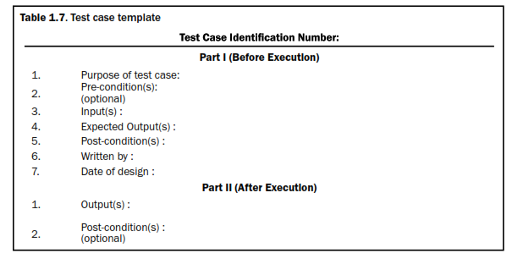
Test case template

Slide 13
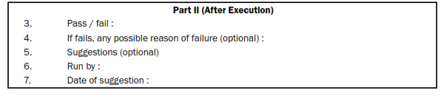
Test case template

Slide 14
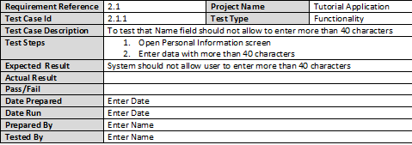
Test case template

Slide 15

Bugs – one of the certainties

Slide 16
Software Testing Myths
Complete testing is possible - If you plan properly, it is possible to test software completely, identify and fix all the defects.
Best practices - Improving quality is simple & straight forward, just follow the best practices.
Testing is demonstration of Zero defect - Testing is completed for this product and test team has signed off the product. This product does not have any defect now.
Anyone can become tester - you should have ability to read and follow instructions, that's it. Testing is not a creative job and does not require special trainings or skills and that's why there are not many professional testers around.

Slide 17
Objectives of testing
Primary objective of testing is to find errors and not to prove that there are no errors.
Objectives of testing can be classified into:
Direct objectives
Indirect objectives

Slide 18
Objectives of testing
Direct objectives
To identify and reveal as many errors as possible in the tested software.
To bring the tested software, after correction of the identified errors and retesting, to an acceptable level of quality.
To perform the required tests efficiently and effectively, within budgetary and scheduling limitations.
Indirect objective
To compile a record of software errors for use in error prevention (by corrective and preventive actions).

Slide 19
Software test classifications
Software tests may be classified according:
to the testing concept or
to the requirements classification

Slide 20
Classification according to testing concept
Two opposing concepts for testing a software:
Functional aspects
Internal structure
Based on the above two opposing concepts or approaches to software quality two testing classes have been developed.
Black box testing
White box testing
Grey box testing

Slide 21
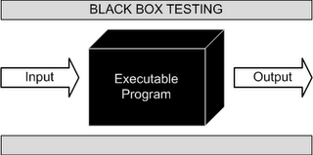
Black Box Testing – IEEE Definitions
Testing that ignores the internal mechanism of a system or component and focuses solely on the outputs generated in response to selected inputs and execution conditions.
Testing conducted to evaluate the compliance of a system or component with specified functional requirements.

Slide 22
Black Box Testing
Testing without knowledge of the internal working of the code being tested.
Also known as functionality testing.
It is subjected to inputs and its outputs are verified for conformance to functional specification.
Attempts to find the following errors:
Incorrect or missing functions
Interface errors
Performance errors

Slide 23

White Box Testing – IEEE Definition
Testing that takes into account the internal mechanism of a system or component.

Slide 24
White Box Testing
Testing based on an analysis of internal workings and structure of a piece of software.
Source code is available to the tester to test the internal working.
Also known as Glass Box testing.
Logical paths are tested by providing test cases that exercise specific sets of conditions and/or loops

Slide 25
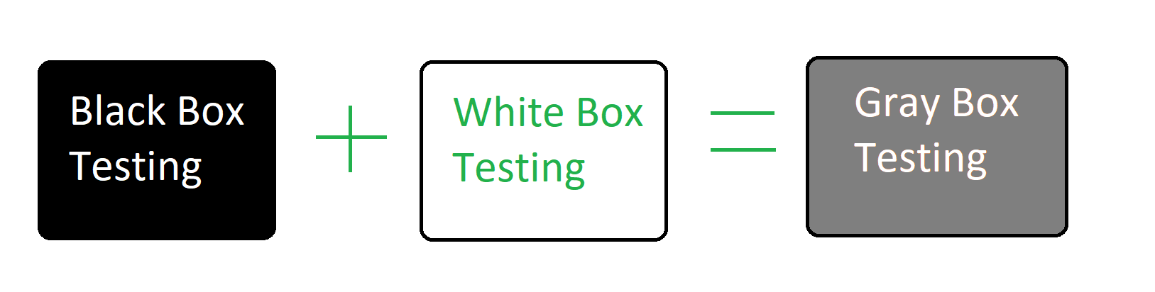
Grey Box Testing
Use knowledge of system’s architecture to create a more complete set of black box tests
Verifying auditing and logging information
for each function is the system really updating all internal state correctly
System-added information (timestamps, checksums, etc.)
“Looking for Scraps”

Slide 26
Any question????

